Slide 1

Bike Sales Analysis - India
Understanding resale value, depreciation, and regional demand to drive smarter pricing and market decisions across India's bike market.

Slide 2


PROJECT GOAL
Problem Statement
This project analyzes bike sales data across India to understand how resale value, depreciation, and regional demand influence market performance and pricing decisions.
Our goal: identify key factors affecting resale prices, brand performance, and market trends to support data-driven decision-making for dealers and sellers.

Slide 3
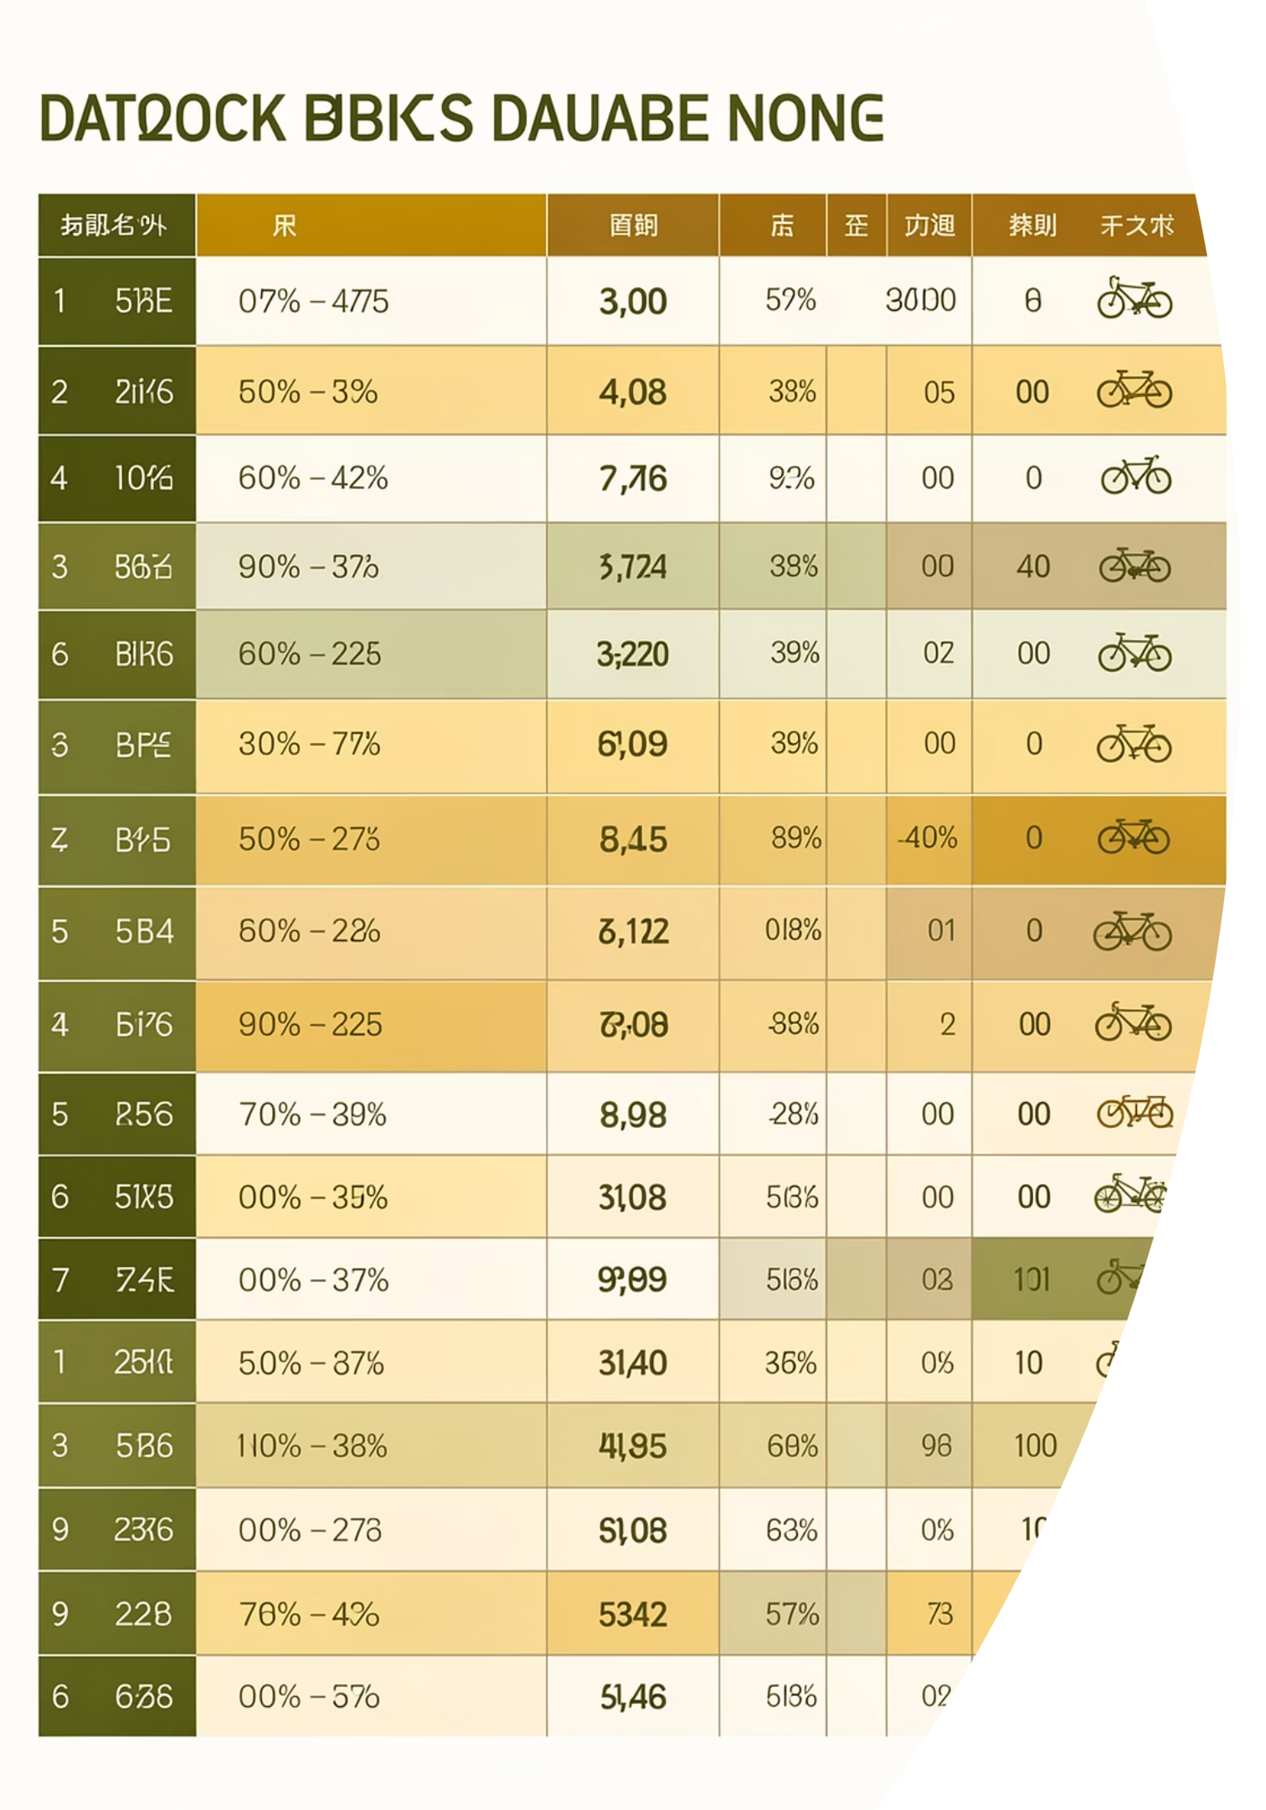
Dataset Overview
Scale
10,000 rows across 18 columns of comprehensive bike sales data
Demographics
Model, state, fuel type, engine cc, insurance status, registration year
Purchase Details
Price, resale price, depreciation, depreciation percentage
Data Quality
Zero missing null values - clean, analysis-ready dataset

Slide 4
EDA Using Python
01
02
Data Loading & Exploration
Data Quality Checks
Imported dataset using pandas, checked structure with df.info() and summary statistics with .describe()
Verified no null values or duplicated data, ensuring dataset integrity
03
04
Column Standardization
Outlier Detection
Renamed columns to snake_case for better readability and documentation
Performed outlier analysis on price and resale_price to identify extreme values

Slide 5

Feature Engineering
New Variables Created
Depreciation calculated as price minus resale_price
Depreciation percentage derived from depreciation values
Price segments categorized from price data
Depreciation
Depreciation %
Price Segment
Connected Python script to PostgreSQL and loaded cleaned DataFrame into database for SQL analysis.

Slide 6
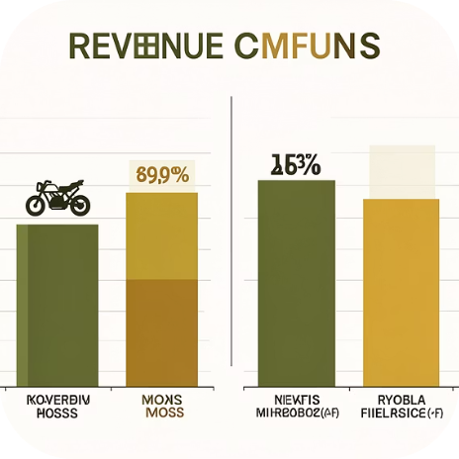



SQL Analysis Insights
Revenue by Brands
Top 5 Brands
Insurance Analysis
Owner Distribution
Compared total revenue across all brands in the dataset
Identified brands with highest average resale prices
Tracked petrol bikes with expired insurance status
Calculated bike counts by owner type categories

Slide 7
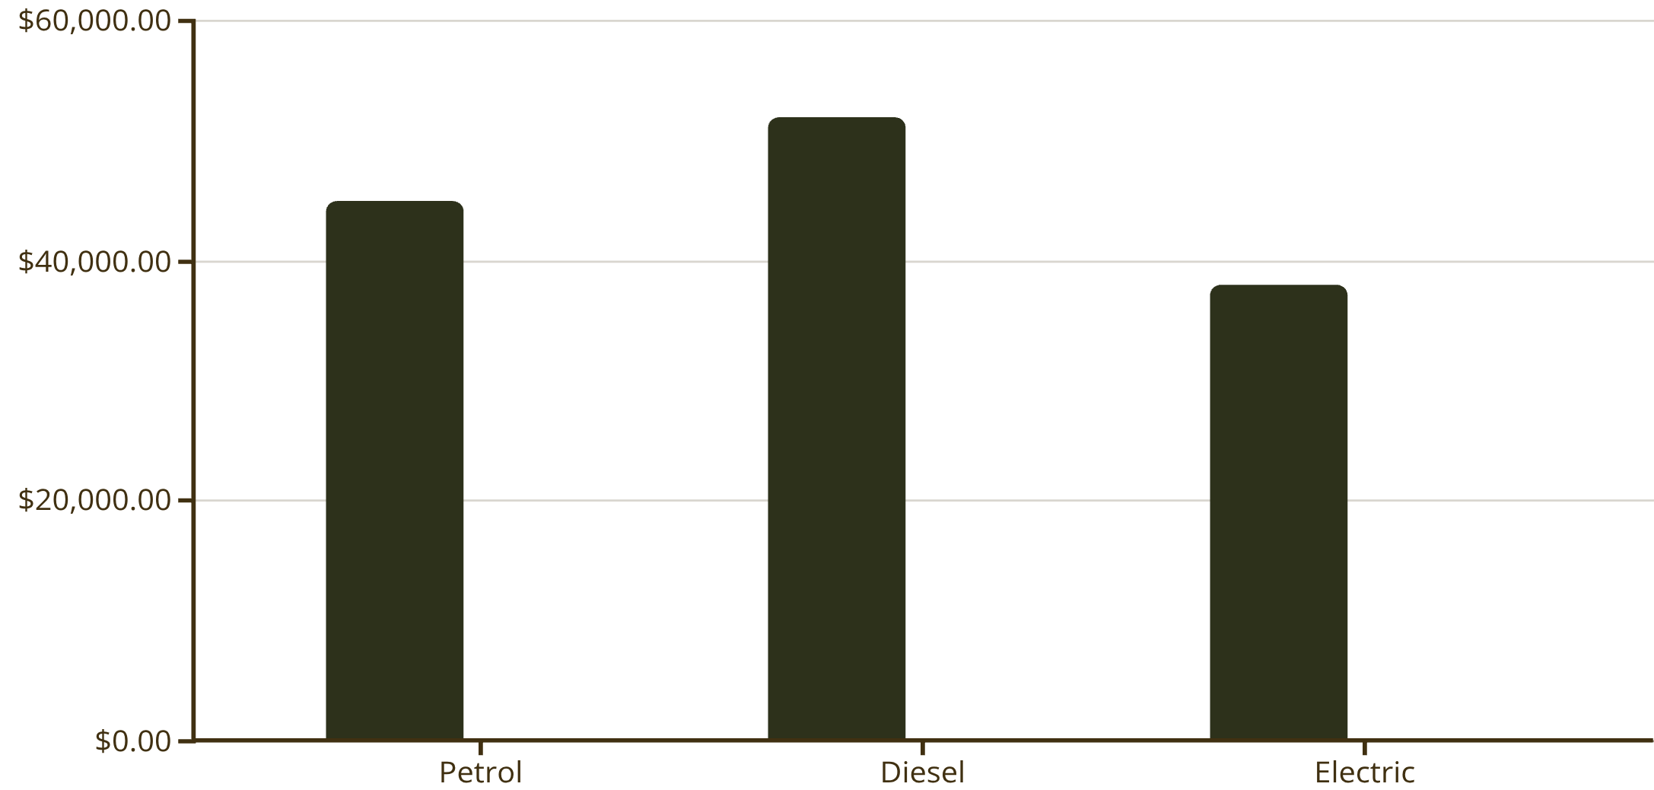
Depreciation by Fuel Type
Electric bikes show the lowest depreciation at 28%, making them the best value retention investment. Petrol bikes depreciate at 35%, while diesel shows the highest depreciation at 38%.
This data reveals clear opportunities for dealers to prioritize fuel types with stronger resale performance.
Avg Depreciation
Depreciation %

Slide 8
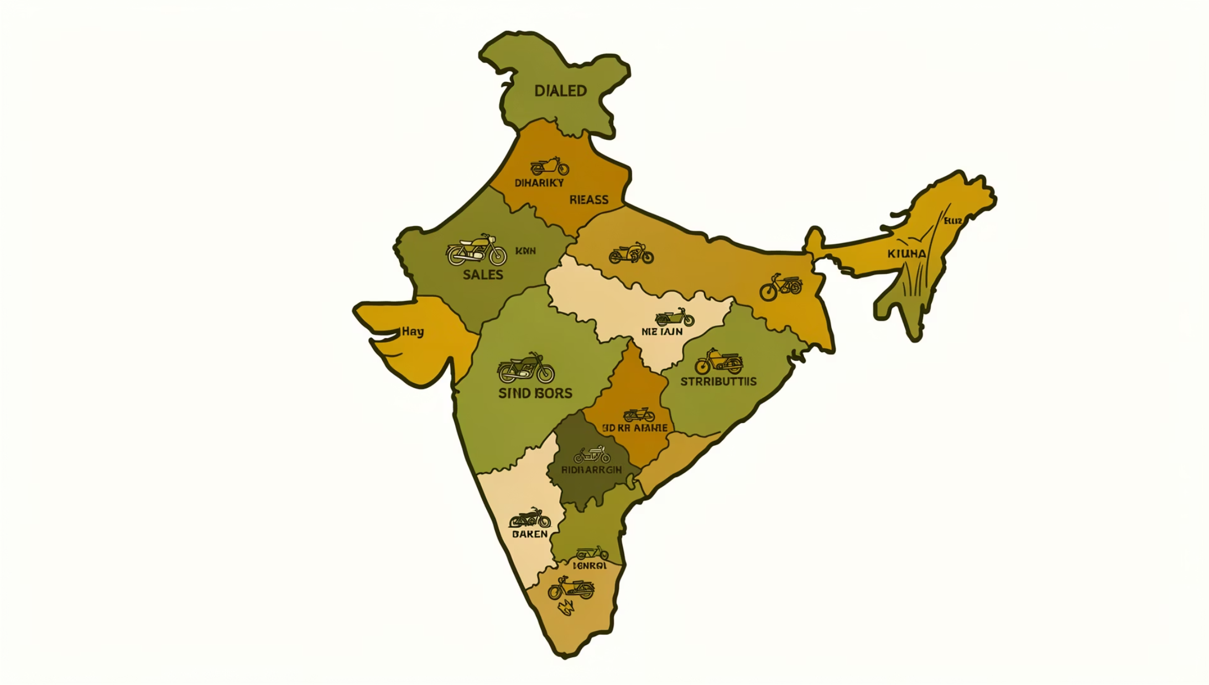
Regional Performance
State Contribution Analysis
Calculated percentage contribution of each state to total resale price, revealing regional market strength and demand patterns.
Brand Rankings
Used window functions to rank brands by average resale price, identifying market leaders and value performers.
Top Models
Applied CTEs to find top 3 bike models per brand by resale price, highlighting best-performing products.

Slide 9
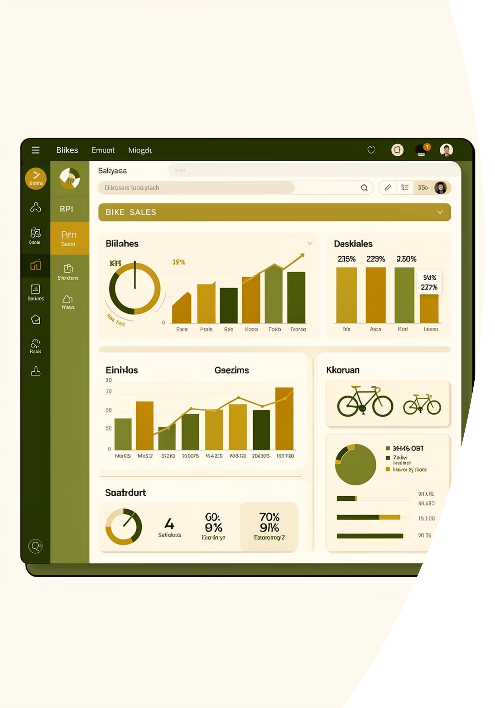
Power BI Dashboard
Built an interactive Power BI dashboard presenting key insights visually: brand performance, regional trends, depreciation analysis, and resale value patterns across India's bike market.

Slide 10
RECOMMENDATIONS
Business Recommendations
Stock Low-Depreciation Brands
Bundle Insurance Renewals
Prioritize brands with lower depreciation percentages - they retain higher resale value and reduce inventory risk in the used-bike market.
Bikes with expired insurance show lower resale value. Offer insurance renewal packages at resale to improve buyer confidence and accelerate sales.
Promote Value-Retention Fuel Types
Expand High-Performing Brands
Actively market fuel types with lower average depreciation to maximize long-term value retention for customers.
Prioritize brands with strong, consistent sales across multiple states - they indicate stable demand and wider market acceptance.

